Slide 1
Multi-Core Packet Scattering to Disentangle Performance Bottlenecks
Yotam Harchol
The Hebrew University
Joint work with Y. Afek, A. Bremler-Barr, D. Hay and Y. Koral.
This work was supported by European Research Council (ERC) Starting Grant
no. 259085, and appeared in HPSR'11 and ANCS’12.
Notes:
affiliations

Slide 2


Network Intrusion Detection Systems
Very popular middlebox
  May be deployed in various places within the network
Reports or drops malicious packets
  How to identify malicious packets?
Internet
Notes:
Prevent attacks on applications in the network

Slide 3

Deep Packet Inspection (DPI)
Search for malicious patterns within packets’ payload
  Exact string patterns/signatures
  Patterns defined as regular expressions
  Often combined with information from header fields
DPI is the heaviest processing component of NIDS
  Why not use many machines/cores to speed it up?
Pipeline multi-core, not efficient.
  Imbalance of pipeline stations, DPI much heavier
Parallel multi-core?

Slide 4
Multi-Core Deep Packet Inspection (DPI)
Option 1: Each core scans for a subset of the pattern-set
Core 1
Pattern Set 1
Core 2
Pattern Set 2
Core 3
Pattern Set 3
Core 4
Pattern Set 4
Notes:
This option is less efficient because scanning time per byte is usually constant (?)
Independently of the size of pattern set, except for the cases I will discuss later

Slide 5
Multi-Core Deep Packet Inspection (DPI)
Option 2: All cores are the same,
Load-balance between cores
Core 1
DPI
Core 2
DPI
Core 3
DPI
Core 4
DPI
Notes:
Load balance packets or flows between the cores

Slide 6





Complexity DoS Attack Over NIDS
Regular operation
2 Steps attack:
normal
malicious
Attacker
heavy
Malicious packets aim to hurt the application
  NIDS should be able to deal with them with no degradation in performance
Heavy packets aim to hurt the NIDS
  They will do nothing to the application
1. Kill IPS/FW
Internet
2. Launch original attack (e.g., steal credit cards)
Notes:
We present "heavy" packets
Exploit the gap between the average and worst case performance

Slide 7

Attack on Security Elements
Combined Attack:
DDoS on Security Element exposed the network – theft of customers’ information
Notes:
May 2011

Slide 8

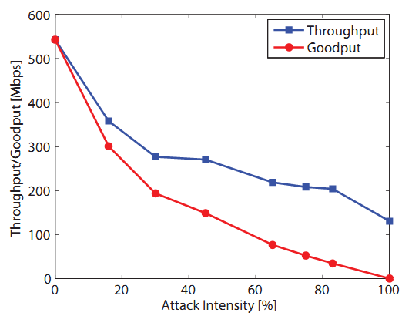
Attack on Snort
The most widely deployed IDS/IPS worldwide.
Heavy packets rate
Notes:
Real-life HTTP traces, alexa
Throughput: the total number of traffic handled by the NIDS
Goodput: the total number of traffic handled by the NIDS not including the heavy packets

Slide 9
OUR GOAL:
MCA²: Multi-Core Architecture for Mitigating Complexity Attacks

Slide 10
Airline Desk Example
Notes:
----- Meeting Notes (10/17/13 12:26) -----
Let's start with an example from a different domain

Slide 11


Airline Desk Example
Boarding pass, please
Notes:
התקפה
כל הארבע מקבלות חבילה גדולה

Slide 12

Airline Desk Example
Overweight!!!
An isle seat near window!!
Can’t find passport!!
1 min.
20 min.
Three carry on handbags!!!
Free first class upgrade!!
Notes:
התקפה
כל הארבע מקבלות חבילה גדולה

Slide 13
Airline Desk Example
Notes:
התקפה
כל הארבע מקבלות חבילה גדולה

Slide 14
Airline Desk Example
Special training
Domain Properties
Heavy & Light customers.
Easy detection of heavy customers.
Moving customers between queues is cheap.
Heavy customers have special more efficient processing method.
packets
1 min.
4 min.
packets
packets
packets
Notes:
התקפה
כל הארבע מקבלות חבילה גדולה

Slide 15

Some packets are much “heavier” than others
Property 1 in Snort Attack
The Snort-attack experiment

Slide 16
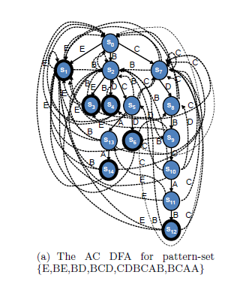
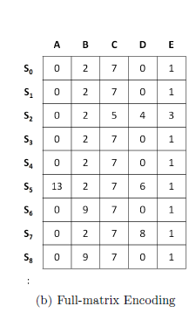
Snort uses Aho-Corasick DFA
DPI mechanism is a main bottleneck in Snort
Allows single step for each input symbol
Holds transition for each alphabet symbol
Fast & Huge
Cache
Main Memory
Best for normal traffic
Exposed to cache-miss attack

Slide 17
Crafting HEAVY packets
Heavy packets factory
Snort patterns database
Chop last
2 bytes

Slide 18

Snort-Attack Experiment
Domain Properties
Heavy & Light packets.
Easy detection of heavy packets
Moving packets between queues is cheap.
Heavy packets have special more efficient processing method.
Normal Traffic
Attack Scenario
Cache
Main Memory
Cache-miss!!!
Does not require many packets!!!
Notes:
כל צעד זה cache miss

Slide 19

Detecting heavy packets is feasible
Property 2 in Snort Attack

Slide 20
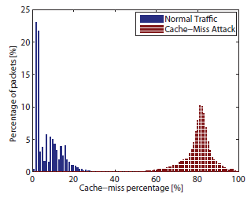
How Do We Detect?
Common states are detected through training traffic set
Tradeoff: Attack effectiveness vs. false positive/negative rates
threshold
non-common states percentage
Notes:
Two distribution functions

Slide 21
How Do We Detect?
Common States
Non
Common States
# Not Common States
α
Heavy packet :
≥
After at least
20 bytes
# Common States

Slide 22
Domain Properties
Heavy & Light packets.
Easy detection of heavy packets
Moving packets between queues is cheap.
Heavy packets have special more efficient processing method.

Slide 23
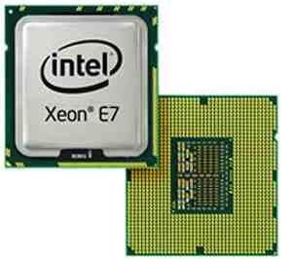

System Architecture
Detects heavy packets
NIC
Q
Core #1
Q
Core #2
Processor Chip
Routine Mode:
Load balance between cores
Q
Core #8
Core #9
Q
Core #10
Q

Slide 24
System Architecture
Detects heavy packets
NIC
Q
Core #1
Q
Core #2
Processor Chip
Alert Mode:
Dedicated cores for heavy packets
Others detect and move heavy to Dedicated.
Q
Core #8
Dedicated Core #9
B
B
Q
B
Dedicated Core #10
Q
B

Slide 25
Inter-Thread Communication
Non-blocking IN-queues
  Single reader,
  single writer,
  lock-free queues
Dedicated cores
in-queues are blocking
(using test&set locks)
  Non-dedicated threads “steal” packets from
  the HoL when sending a
  heavy packet
NIC
Q
Core #1
Q
Core #2
Processor Chip
Q
Core #8
Dedicated Core #9
B
B
Q
B
Dedicated Core #10
Q
B

Slide 26
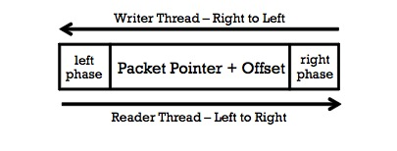
Inter-Thread Communication
In queues and Heavy packets queues are lock-free
– no locking mechanisms are used
Cyclic queue, conflicts are resolved by
marking two phases on the queue.
  Changes after the entire queue is written to
Writer writes to the queue from right to left:
  Check whether reader_phase=writer_phase or tail>head; otherwise queue is full
  Right_phase ← writer_phase
  Write packet_pointer + offset
  Left_phase ← writer_phase
Reader reads in the opposite direction:
  First reads left_phase bit, then packet, then right_phase bit.
  If left_phase != right_phase: record is being written; retry.
  If left_phase = right_phase != reader_phase: queue is empty
  Otherwise, valid packet is read

Slide 27
Domain Properties
Heavy & Light packets.
Easy detection of heavy packets
Moving packets between queues is cheap.
Heavy packets have special more efficient processing method.

Slide 28
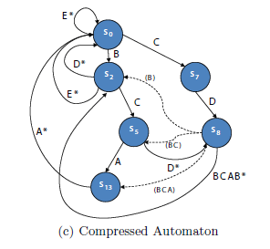
Snort uses Aho-Corasick DFA
Huge memory footprint
Single memory access per input symbol
Small memory footprint
Multiple memory accesses per input symbol
Notes:
COMPRESSION TRADES SPACE FOR TIME

Slide 29
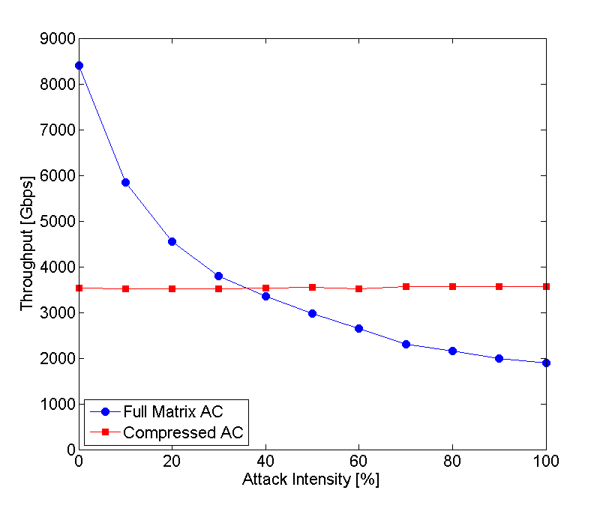
Full Matrix vs. Compressed
In cache
One memory access per symbol
Always in cache
Multiple
memory accesses
per symbol
Not in cache
Heavy packets rate
Notes:
END: If we have a core that mostly handles heavy packets, it might be good to use the compressed implementation

Slide 30
Domain Properties
Heavy & Light packets.
Easy detection of heavy packets
Moving packets between queues is cheap.
Heavy packets have special more efficient processing method.

Slide 31
Experimental Results
Notes:
We implemented the system and…

Slide 32
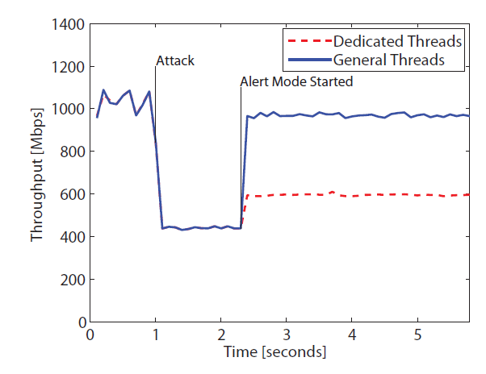
System Throughput Over Time
Reaction time can be smaller
Notes:
We implemented the system and…

Slide 33
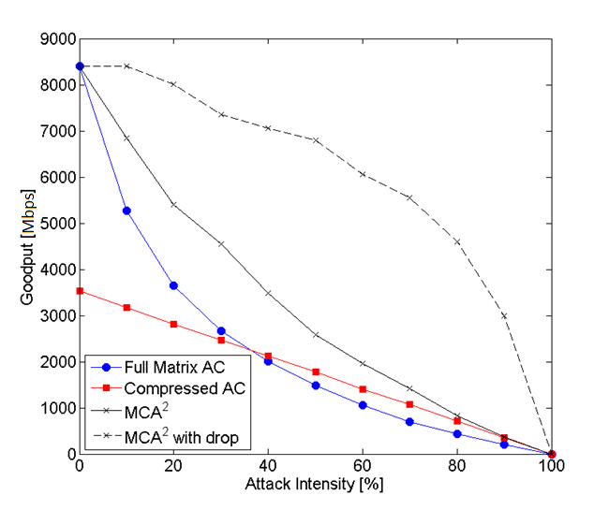
Different Algorithms Goodput
Complexity
Attack
Bandwidth
Attack
Notes:
Goodput is the throughput on "good" packets
The higher the attack bandwidth is, less "good" packets exist

Slide 34

Additional Application for MCA²
The Hybrid-FA-attack experiment
Notes:
The approach is general, as long as the properties are satisfied
Here is another experiment we made that shows that

Slide 35
Hybrid-FA
Space-efficient data structure for regular expression matching
Faster than NFA
Structure:
  Head DFA
  Border states
  Tail DFAs
More than one state can be active
at the same time!
s₀
E
C
B
s₁
s₂
s₇
E
D
C
D
s₃
s₄
s₅
s₈
D
[^\n]*
B
A
s₁₃
s₆
s₉
.*
A
C
s₁₄
s₁₀
A
s₁₁
B
s₁₂

Slide 36
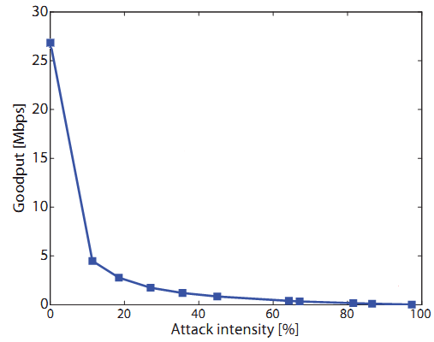
Hybrid-FA Attack
s₀
s₀
E
C
Normal Traffic
Attack Scenario
B
s₁
s₂
s₂
s₇
s₇
E
D
C
D
s₃
s₄
s₅
s₈
s₅
s₈
A
D
[^\n]*
B
s₉
s₁₃
s₆
s₉
s₁₃
.*
A
C
s₁₄
s₁₀
s₁₀
A
s₁₁
s₁₁
B
s₁₂
s₁₂
Input:
C
D
B
B
C
A
B
Again: Does not require many packets!!!

Slide 37
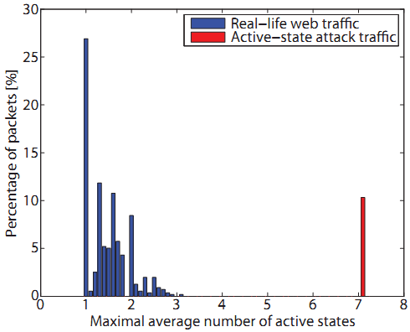
Heavy Packet Detection
threshold

Slide 38
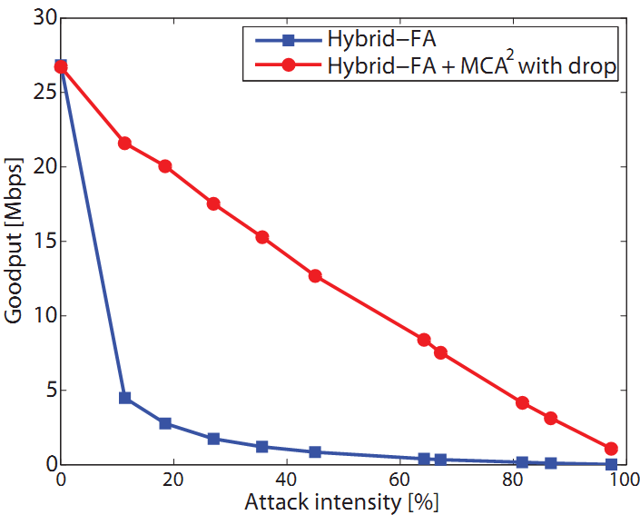
MCA² With Hybrid-FA

Slide 39
Concluding Remarks
A multi-core system architecture, which is robust against complexity DoS attacks
This talk focused on specific NIDS and complexity attack
  But also shows other NIDS (e.g., Hybrid-FA)
  More issues are dealt in the paper (e.g., dealing with flows rather than single packets etc.)
We believe this approach can be generalized (outside the scope of NIDS).

Slide 40
Thank You!!

Slide 41
Extra Slides…

Slide 42
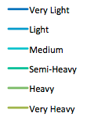
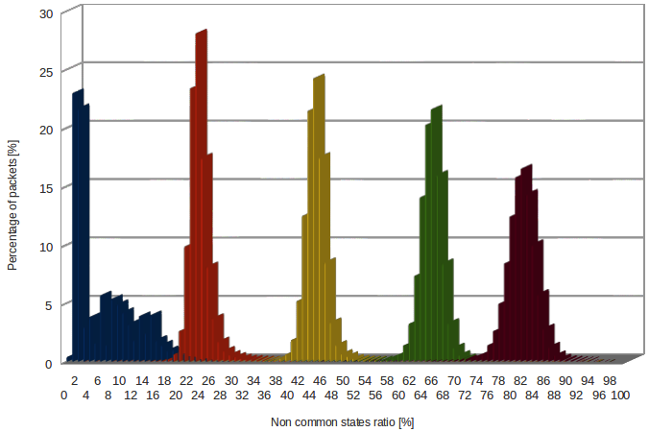
Detection Tradeoff
Attacker can use "lighter" heavy packets to
get below threshold
Different attack traffic
With growing "heaviness"
"Regular" traffic
Medium
Semi-Heavy
Heavy
Very
Heavy
Percentage of packets
non-common states percentage

Slide 43
Detection Tradeoff
The effect of "lighter" packets on throughput
-17%
-23%
-41%
-44%
-62%
-66%

