Slide 1
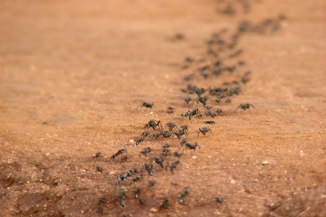
The Power of Pheromones in Ant Foraging
Christoph Lenzen
Tsvetormira Radeva

Slide 2
Background
Feinerman and Korman, DISC ’12:
Memory Lower Bounds for Randomized Collaborative Search and Implications to Biology
Feinerman et al., PODC ’12:
Collaborative Search on the Plane without Communication
- ants search for a food item on 2-dimensional grid
- ants know their position
- no communication (after leaving the nest)
- oracle provides B bits (before the search)
- minimize T(k,D): time for k ants to find food in distance D

Slide 3
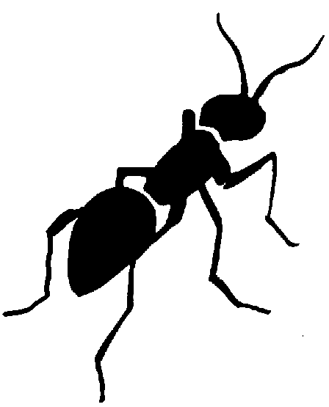
Background: (Trivial) Lower Bound
minimize T(k,D): time for k ants to find food in distance D
T(k,D) ≥ 2D
T(k,D) ≥ 4D(D+1)/k

Slide 4
Background: Oracle Size Lower Bound
Feinerman and Korman, DISC ’12:
Memory Lower Bounds for Randomized Collaborative Search and Implications to Biology
Feinerman et al., PODC ’12:
Collaborative Search on the Plane without Communication
…provides asymptotically matching bounds
T(k,D) in O((D+D²/k) log^{1-ε} k)
→ Ω(log log k) oracle bits

Slide 5
Background: Algorithm by F. et al.
1. use oracle bits to encode (approximation of) k
2. for C=1,…
for c=1,…,C
move to random grid point in distance ≤ 2^{c}
spiral search 4∙2^{2c}/k grid points
return to nest

Slide 6
Background: Algorithm by F. et al.
+ asymptotically optimal…
- …with constant approximation of k (log log k oracle bits)
+ highly fault-tolerant
+ asynchronous
- Ω(log D) state bits
- exact counting required

Slide 7
Background: Algorithm by F. et al.
+ asymptotically optimal…
- …with constant approximation of k (log log k oracle bits)
+ highly fault-tolerant
+ asynchronous
- Ω(log D) state bits
- exact counting required
Can we avoid this with
indirect communication?

Slide 8
New: Adding Pheromones
Assumption: ants “mark” each visited grid point
- ants sense pheromones
on adjacent points
- also: ants now know
direction of, but not
distance to nest

Slide 9
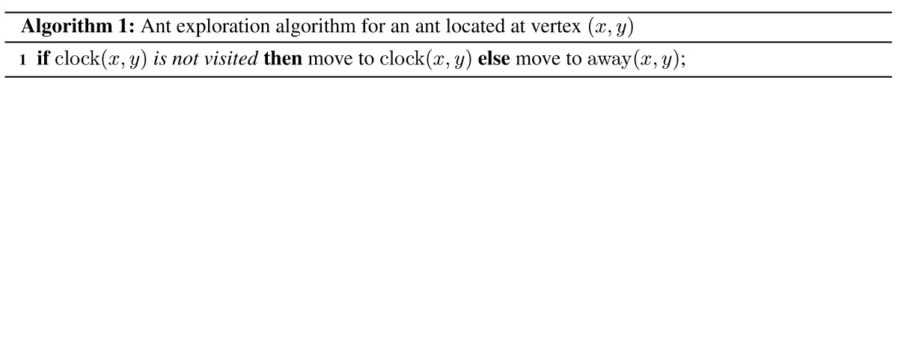
Algorithm
clock
away

Slide 10
How It May Look Like
Works
asynchronously?

Slide 11
Analysis
Lemma 1
Suppose (x,y) is marked, but clock(x,y) is not.
Then there is an ant on (x,y).
Proof:
Suppose (x,y) is marked, but clock(x,y) not.
→ Some ant moved to (x,y) at some point, marking it.
→ It must still be there, as it would move to clock(x,y) and mark it upon leaving.

Slide 12
Analysis
Lemma 1
Suppose (x,y) is marked, but clock(x,y) is not.
Then there is an ant on (x,y).
Corollary
If an ant reaches distance D from the nest,
8D asynchronous rounds later all grid points
in distance at most D from the nest are visited.

Slide 13
Analysis
Lemma 2
Within D+4D(D+1)/k asynchronous rounds,
an ant reaches distance D from the nest.
Proof:
There are 4D(D+1) unmarked grid points within distance D.
Each move marks a grid point or leads away from the nest.
→ Within D+4D(D+1)/k rounds, an ant reaches distance D.

Slide 14
Analysis
Theorem
The algorithm is 5.5-competitive.
- if ants move counterclockwise if the clockwise direction is explored, this improves to factor 3.5
- proof goes by showing an analog to Lemma 1 for the counterclockwise direction

Slide 15
Summary of Results
+ asymptotically optimal algorithm
+ very simple (no memory, no counting, deterministic)
+ asynchronous
- no fault-tolerance/robustness
- requires repelling pheromone

Slide 16
Summary of Results
+ asymptotically optimal algorithm
+ very simple (no memory, no counting, deterministic)
+ asynchronous
- no fault-tolerance/robustness
- requires repelling pheromone

Slide 17
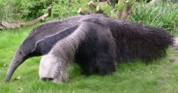
Robustness Issues
- obstacles
- dying/disappearing ants
- self-stabilization
- continuously appearing targets
…

Slide 18
Robustness Issues
- obstacles
- dying/disappearing ants
- self-stabilization
- continuously appearing targets
…
deals locally with one
dying ant (maybe two
with modification)
Also move towards
nest if unexplored!

Slide 19
Robustness Issues
- obstacles
- dying/disappearing ants
- self-stabilization
- continuously appearing targets
…
requires some degree
of synchrony (analysis
becomes challenging)
Also move towards
nest if unexplored!

Slide 20
Robustness Issues
- obstacles
- dying/disappearing ants
- self-stabilization
- continuously appearing targets
…
Multiple pheromones?
repeat search with different pheromones

Slide 21
Summary of Results
+ asymptotically optimal algorithm
+ very simple (no memory, no counting, deterministic)
+ asynchronous
- no fault-tolerance/robustness
- requires repelling pheromone

Slide 22
Very Nice, but…
…it turns out that ants don’t use pheromones that way!
possible reasons:
- cost in producing pheromone
- danger of alerting enemies
- robust variants inefficient or complicated?
Is the approach useful in other contexts?
- other animals?
- robots sweeping an area (if literal, marking is implicit)?

