Slide 1
Fighting noise with limited resources: an ant colony perspective
1st Workshop on Biological Distributed Algorithms
October, 2013
Ofer Feinerman
Dept. of Physics of Complex Systems
Weizmann Institute of Science

Slide 2
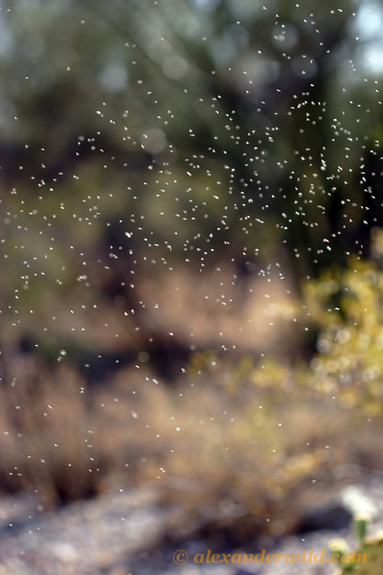

The nuptial flight
Striking Collective performance:
synchrony a single hour of a specific date.
Individuals are limited: Virgin queens differ in their sensitivity to heat/ light/humidity. (NOISE – can destroy synchrony)
Interactions: to restore synchrony–
“if your neighbor takes then you can take off as well”
This naïve solution is not good enough because then collective behavior becomes dominated by a few over-sensitive virgin queens.
Notes:
The most important day of the ants’ year.
Reproduction.
Virgin queens and males from different nests exit the nest fly and mate.
The most striking aspect of this phenomena is its synchrony: you need to, at least, bring the bride and the groom to the place at the same time.
Highly synchronized event.
Starts at 6PM of the first hot day after summer and lasts for about an hour.
Positive feedbacks produce the desired runway effect.

Slide 3
The nuptial flight
Striking Collective functionality:
Synchronous down to a single hour of a specific date.
How do they do it?
Notes:
The most important day of the ants’ year.
Reproduction.
Virgin queens and males from different nests exit the nest fly and mate.
The most striking aspect of this phenomena is its synchrony: you need to, at least, bring the bride and the groom to the place at the same time.
Highly synchronized event.
Starts at 6PM of the first hot day after summer and lasts for about an hour.
Positive feedbacks produce the desired runway effect.

Slide 4
Timing the nuptial flight
Possible answer: All virgin queens are precisely tuned to fly at specific weather conditions.
Notes:
This is just a field observation – due to their rarity studying nuptial flight is somewhat of a task.
In this movie we see one of these over-responsive queen.
She really wants to fly off into her future.
Society holds her back. Study of ants is useful for people with limited abstractization skills: negative feedbacks look like negative feedbacks.
This is early negative feedback – which coupled with the positive feedback (mentioned in previous slide) allows strong reactions which are nevertheless precisely timed.
This double feedback system is prevalent in biology.
Here it may be achieved by ants that follow very simple rules:
“if you see a virgin queen try to pull her back in the nest”.
This will keep small numbers of highly sensitive queens at check.

Slide 5
Timing the nuptial flight
Possible answer: All virgin queens are precisely tuned to fly at specific weather conditions.
Noise: In biological systems such exact tuning is difficult, costly, and rare.
Notes:
This is just a field observation – due to their rarity studying nuptial flight is somewhat of a task.
In this movie we see one of these over-responsive queen.
She really wants to fly off into her future.
Society holds her back. Study of ants is useful for people with limited abstractization skills: negative feedbacks look like negative feedbacks.
This is early negative feedback – which coupled with the positive feedback (mentioned in previous slide) allows strong reactions which are nevertheless precisely timed.
This double feedback system is prevalent in biology.
Here it may be achieved by ants that follow very simple rules:
“if you see a virgin queen try to pull her back in the nest”.
This will keep small numbers of highly sensitive queens at check.

Slide 6

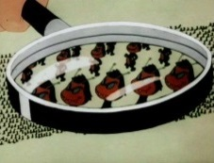
Timing the nuptial flight
Possible answer: All virgin queens are precisely tuned to fly at specific weather conditions.
Noise: In biological systems such exact tuning is difficult, costly, and rare.
Behavioral rule: “Pull exiting virgin queens back into their nest.”
- decentralized - works until there are too many queens to handle
Negative + positive feedback: a collective mechanism for noise suppression.
Notes:
This is just a field observation – due to their rarity studying nuptial flight is somewhat of a task.
In this movie we see one of these over-responsive queen.
She really wants to fly off into her future.
Society holds her back. Study of ants is useful for people with limited abstractization skills: negative feedbacks look like negative feedbacks.
This is early negative feedback – which coupled with the positive feedback (mentioned in previous slide) allows strong reactions which are nevertheless precisely timed.
This double feedback system is prevalent in biology.
Here it may be achieved by ants that follow very simple rules:
“if you see a virgin queen try to pull her back in the nest”.
This will keep small numbers of highly sensitive queens at check.

Slide 7
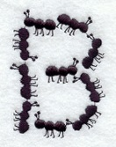
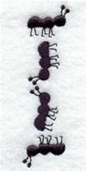
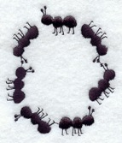
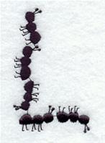
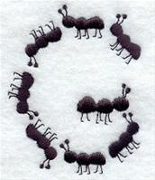
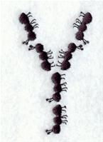

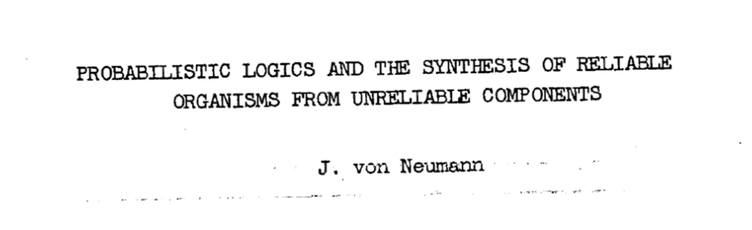
Distributed Computing
Biological ensembles (animals, microbes, cells) | Groups of processors (computers, robots, sensors)
Noisy individuals | Limited computational resources
No central control | No central control
Interactions: Noise, social networks | Communication: Faults, connectivity graphs
Behavioral rules | Algorithms
Collective functionality (evident on scales that are larger than an individual) | Collective performance (e.g. running time)
Local algorithm
Methodology
Observing natural groups, unknown model, search for consistent descriptions | Proposing models, inventing algorithms, setting bounds on performance
Notes:
Shannon – 1956, von Neumann – 1952.
Noise: sensing, communication, (ants are small) sampling of the environment of interactions.
Some limitations ants may have: Vocabulary size and plasticity, Anonymous ants (no strong network structure), limits on memory and computation.

Slide 8

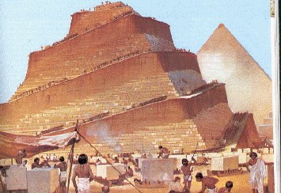
Distributed Computing
Natural Sciences | Mathematics
Observing natural groups, unknown model, search for consistent descriptions | Proposing models, inventing algorithms, setting bounds on performance
Reverse engineering | Engineering
Notes:
Shannon – 1956, von Neumann – 1952.
Noise: sensing, communication, (ants are small) sampling of the environment of interactions.
Some limitations ants may have: Vocabulary size and plasticity, Anonymous ants (no strong network structure), limits on memory and computation.

Slide 9
Introduction -biology
Ants are small and biological
and therefore inherently noisy.
Ant colony reacts to its environment
Limited resources:
Noise: sensing, communication, (ants are small) sampling.
Resources: Limited vocabulary, limited memory (social interactions), noisy communication.
Single ant behavioral rules that comply with the constraints and lead a reasonable collective reaction to environmental cues.
Ant colonies show
robust reactions to a changing environment.
The problems ants face are somewhat different than what was addressed in the 50’s:
Ants may have limitations but they are not logic gates
Ants do not function within a well structured network.
Observe how real ants deal with the reliability problem.
Longer term goal lies in drawing connections similar to those obtained in Computer Science.
Notes:
Shannon – 1956, von Neumann – 1952.
Noise: sensing, communication, (ants are small) sampling of the environment of interactions.
Some limitations ants may have: Vocabulary size and plasticity, Anonymous ants (no strong network structure), limits on memory and computation.
Connections: start to put measures and units on observed quantities. (e.g. information flow -> measure bits)

Slide 10
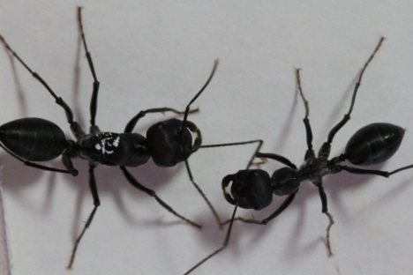
Notes:
Cataglyphis niger
Paratrechina longicornis

Slide 11
Observe: Desert ant recruitment
Design an experiment where
collective function
is evident:
Starved ants
bring food to nest
Noisy interactions: First recruitment attempt failed.
Reminds us of a rumor spread problem...
Notes:
No noise in sensing the environment

Slide 12
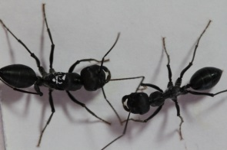
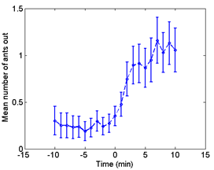
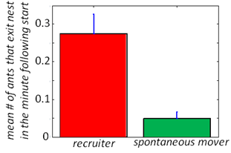
Collective performance
and discriminate recruitment from other movements within nest
Ants recruit to food source

Slide 13
Reverse engineering:
Propose a model and an algorithm:
“Model”: ants can stay in nest or move around to find food, ants can remember finding food and communicate this perfectly.
“Algorithm”:
Stay immobile in nest
With low probability: exit search for a while and return to nest.
if told of food: exit the nest immediately.
If found food: remember this, go to nest and tell others.
Consistency: is our explanation consistent with observations?
We will focus on an essential ingredient of our model:
A two word (1 bit) vocabulary
We predict a quick exit following an interaction with recruiter.

Slide 14
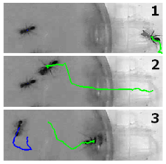
Quantifying communication
We quantify communication indirectly
by measuring the behavioral change
that is induced by interactions.
Notes:
What are these ants saying to each other?
Indirect method: if we can infer by the behavior of the ant how much she heard she must know at least this much…
Advent and availability of computer and camera technology is revolutionizing the field of collective animal behavior.

Slide 15

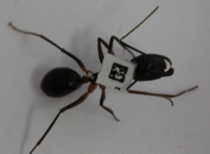

Quantifying communication
We quantify communication indirectly
by measuring the behavioral change
that is induced by interactions.
Obstacle: This requires a lot of interaction statistics!
Technology is currently revolutionizing the field of collective animal behavior.
+
Notes:
What are these ants saying to each other?
Advent and availability of computer and camera technology is revolutionizing the field of collective animal behavior.

Slide 16
Quantifying communication
We quantify communication indirectly
by measuring the behavioral change
that is induced by interactions.
Obstacle: This requires a lot of interaction statistics!
Technology is currently revolutionizing the field of collective animal behavior.
+
Repeating the experiment ~50 times gave us a database of 1000’s of interactions.
Notes:
What are these ants saying to each other?
Advent and availability of computer and camera technology is revolutionizing the field of collective animal behavior.

Slide 17
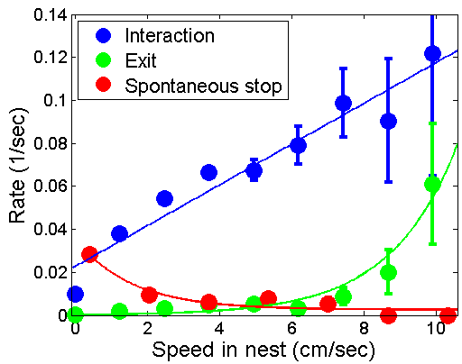

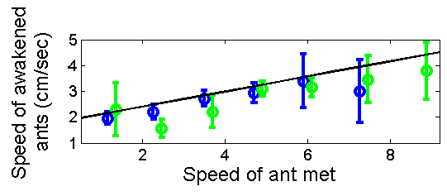
Quantifying communication
We quantify communication indirectly
by measuring the behavioral change
that is induced by interactions.
Obstacle: What behavioral change should we look at?
Movement speed as a window into the ants’ inner states.
But: The probability that an ant exit the nest does NOT on
whether she has recently (last 2 min) met a recruiter (P=0.46).
But: The speed of the ‘awakened’ ant does NOT depend on whether the other ant has been to the cricket (P=0.50).
Notes:
The probability that an ant exit the nest depends on her speed…..
The speed of the ‘awakened’ ant depends on the speed of the interacting ant (P<0.05) but
NOT on whether the other ant has been to the cricket (P=0.50).

Slide 18
Quantifying communication
We quantify communication indirectly
by measuring the behavioral change
that is induced by interactions.
Obstacle: What behavioral change should we look at?
Movement speed as a window into the ants’ inner states.
Speed corresponds to enthusiasm,
The probability that an ant leave the nest depends on her speed.
An ant can gain in speed by meeting fast ants.
Quantifying information transfer:
How sensitive is one ant to the other ant’s speed?
Notes:
The probability that an ant exit the nest depends on her speed…..
The speed of the ‘awakened’ ant depends on the speed of the interacting ant (P<0.05) but
NOT on whether the other ant has been to the cricket (P=0.50).

Slide 19
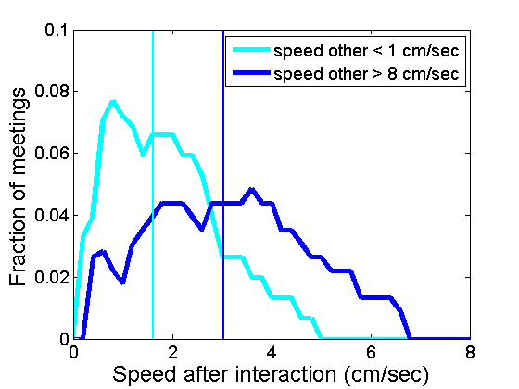
Information in interactions
Define an information channel:
communication noise
ant 2
ant 1
Speed of
ant 1
before interaction
Speed of
ant 2
after interaction
and calculate
the channel capacity.
Experimentally:
one input bit
(fast/slow).
binary channel
0
0
1 bit
1
1
Notes:
and calculate the channel capacity:
“At what rate could information be squeezed through the channel?”
If we look at the means only we see information is passing fast->fast, slow->slow

Slide 20
Information in interactions
Define an information channel:
communication noise
ant 2
ant 1
Speed of
ant 1
before interaction
Speed of
ant 2
after interaction
and calculate
the channel capacity.
Experimentally:
one input bit
(fast/slow).
noisy binary channel
1-p
0
0
1 bit
p
1
1
0.22 bits = 1.2 words
1-p
Notes:
and calculate the channel capacity:
“At what rate could information be squeezed through the channel?”
If we look at the means only we see information is passing fast->fast, slow->slow
Discuss here? Why do we take this lower bound as our estimate?

Slide 21
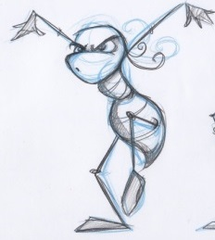
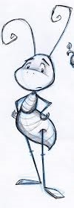
Collective reliability
“Model”: ants can stay in nest or move around to find food,
ants can remember finding food as well as an additional variable that signifies enthusiasm. Enthusiasm can be communicated via noisy interactions.
“Algorithm”:
Behavioral rules
Memory state
1st hand knowledge
“confident”
Assertive
Interact often.
Ignore messages
received in interactions.
cricket
Hesitant
Limit your interactions.
Adjust your enthusiasm according to
message received in interactions.
2nd hand knowledge
“unsure”
Notes:
Decent behavior
1st had knowledge:
Recruiters are knowledgeable, they remain fast and interact often. Interactions do not affect their speed.
“Speak loudly” “Don’t listen”
2nd hand knowledge:
An ant butted by her nest-mate starts moving but cannot be sure why.
These ants exhibit a more hesitant behavior. They react to interactions by changing their own speed.
These changes often makes them stop moving after a small number of interactions.
“Speak softly” “Be responsive”

Slide 22
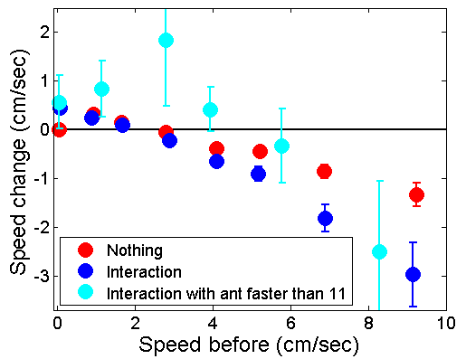
From communication control to reliable group function
Speed modulation of non knowledgeable ants
Slow down (limit your interactions)
Adjust speed after interactions.
Exit
threshold
Fixed point analysis:
A nest in which no ant saw the cricket will converge to fixed points of speed that are well under exit threshold.
The persistent presence of a fast ant (the recruiter) pushes the fixed point towards the exit threshold.

Slide 23
The mechanism at work
Early
negative Feedback
A convicted ant
overcomes
negative feedback

Slide 24
Another way to look at it:
Group level feedbacks
“recruiter”
exit threshold
A bi-stable switch
With exits from the excited state.
speed
“fast”
“slow”
Prediction of “0.22 bit model”:
Moving ants will have lesser effects
as the density of ants within the nest grows.
transition of ants between groups
increase transition rate
decrease transition rate

Slide 25
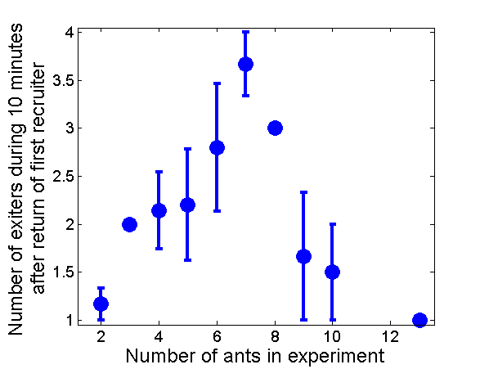
Consistency of new model
Prediction:
Recruiting from a
high density nest
Is more difficult.
Experimental result:

Slide 26
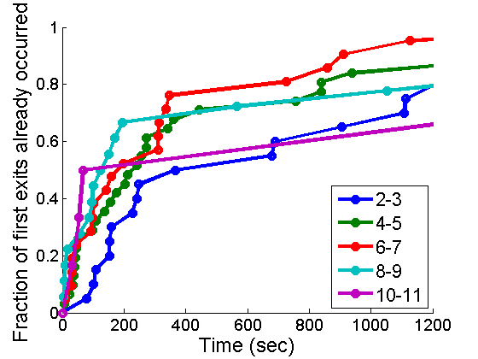
Density effects
Test model’s prediction in 2 scenarios:
recruitment
Exit of 1st ant from nest
Both show a cross over at a density of around 6-7 ants.
Strengthens our hypothesis that
recruitment and spontaneous exits are two sides of the same coin
and that these ants lack a distinguished recruitment message.

Slide 27
Recruitment Summary
Observe how real ants deal with the reliability problem.
Assess information
Tune your influence
Environmental info?
Long lasting confidence
Tune your interaction rate
Tune your response to interactions
Social info?
Transient high speed
J. R. Soc. Interface 10(82), 2013.
A further theoretical goal lies in drawing connections similar to those obtained in Computer Science.
Quantify the cost (e.g. in time) that the ants pay for communicating badly.
Could the ants perform as well with 0 bits of communication?
Notes:
The difference between social and environmental info is consistent with the interactions being noisy.
Influence since the vocabulary is small/noisy you can’t tune what you say therefore you tune what is written.
The ants assess their knowledge of the situation and accordingly tune their influence on the group and their responsiveness to it.
Assessments: An assessment relies on environmental cues is more lasting (confident/unsure) ants
then an assessment that relies on social cues (a fast unsure ant can quickly slow down again).
Tuning: Since the ants have a very small vocabulary they tune the rate at which they interact and the extent at which they respond to interactions.

Slide 28
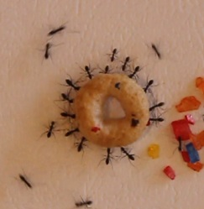
Collective load carrying

Slide 29
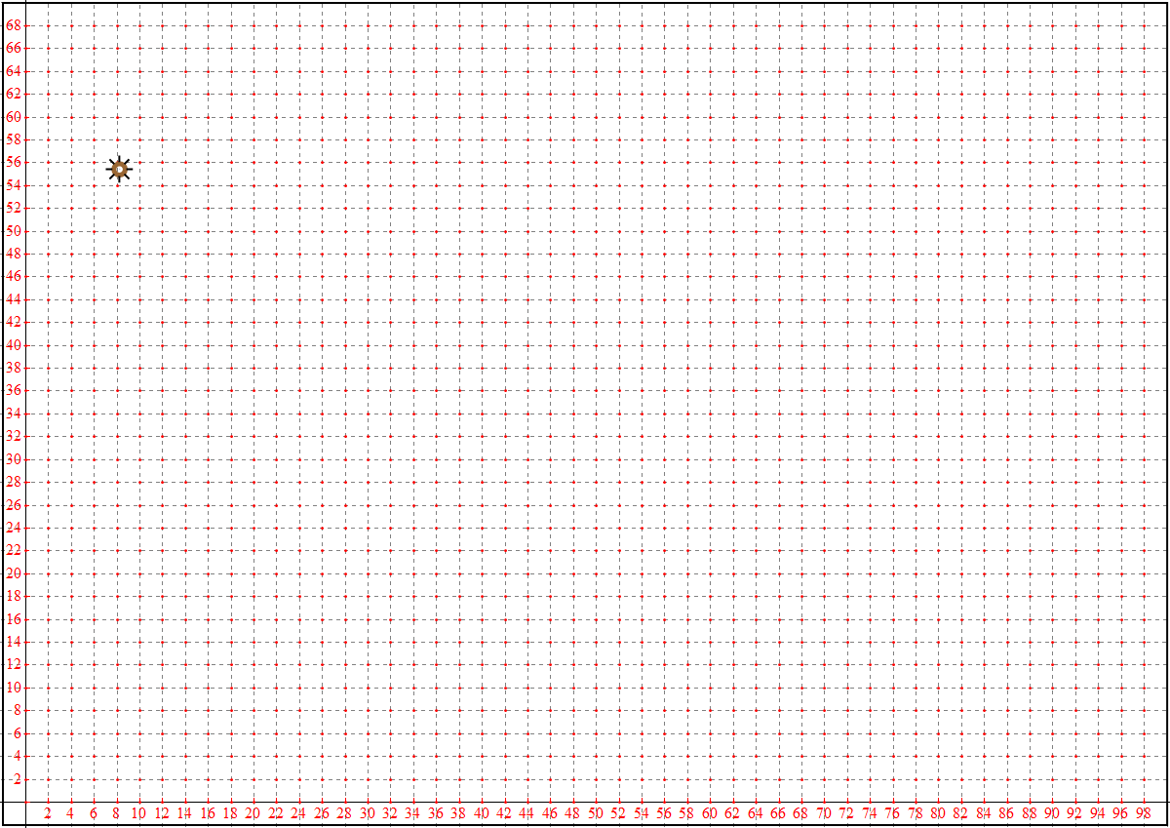
Experimental setup
cm

Slide 30
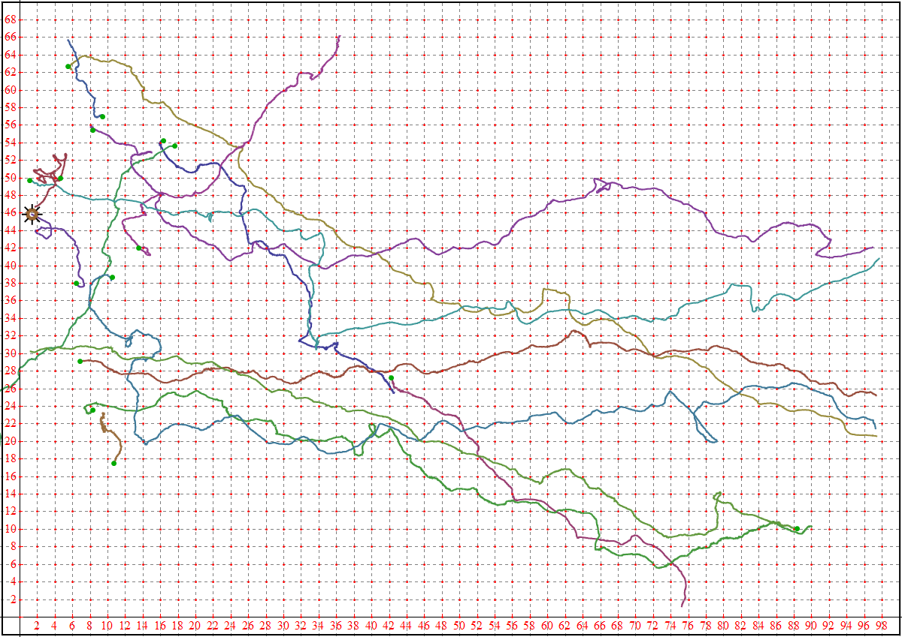
Cheerio Trajectories
cm

Slide 31
Navigational trouble
Home Bound

Slide 32
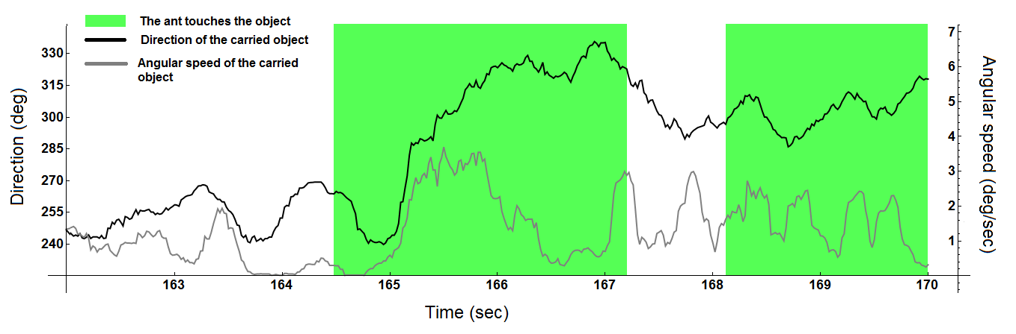
Navigational trouble
Noise: Carriers have trouble realizing the correct direction home.
Individual ants can make a positive difference.
Inertia: there is opposition to change (but also willingness to become convinced).

Slide 33
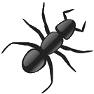
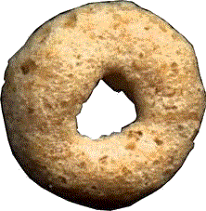
Prominence of the updated
1.
2.
1.
2.

Slide 34
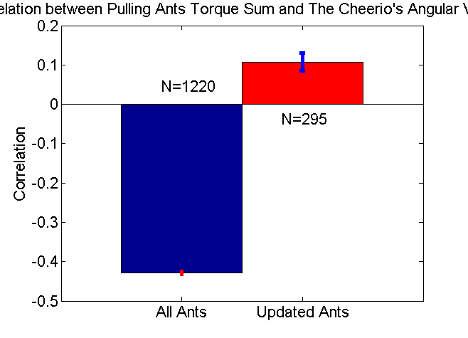
Prominence of the updated
1.
2.
1.
2.
Cheerio Rotation parallel to torque?
Cheerio Speed parallel to force?
Notes:
Updated ants: for Torque, during 10 first seconds of pulling
for Force: 10-15 seconds (give the time to align)

Slide 35
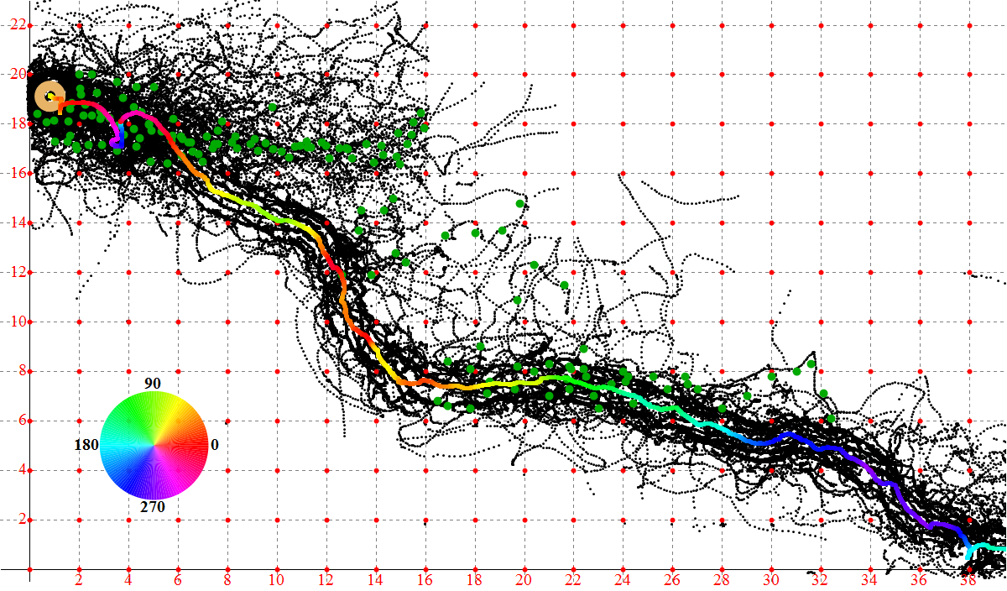
There is more to this story…

Slide 36
Collective Carrying Summary
Observe how real ants deal with the reliability problem.
Assess information
Tune your influence
Are you confident about the direction?
No idea…
Align yourself correctly and pull stronger.
Provide intertia.
knowledge is (pulling) power!
Notes:
The difference between social and environmental info is consistent with the interactions being noisy.
Influence since the vocabulary is small/noisy you can’t tune what you say therefore you tune what is written.
The ants assess their knowledge of the situation and accordingly tune their influence on the group and their responsiveness to it.
Assessments: An assessment relies on environmental cues is more lasting (confident/unsure) ants
then an assessment that relies on social cues (a fast unsure ant can quickly slow down again).
Tuning: Since the ants have a very small vocabulary they tune the rate at which they interact and the extent at which they respond to interactions.

Slide 37

Recruitment Summary
Suffering from noise?
Rely on first hand information.
rare
noisy
Group:
Both amplifies and limits
the influence of this information.

Slide 38
Ants and distributed computing
Ants ➔ DC
A natural model for rumor spread
Definition of communication noise that is different than that typically addressed in CS.
DC ➔ ants
Lower bounds: what is the most efficient algorithm given 0.22 bits for communication.
For which collective goals (e.g. quick response,
low error rate) is the proposed algorithm efficient?
How well could ants do if they had zero bits of communication?

Slide 39
Thanks
Ant Lab
Nitzan Razin
Yael Heyman
Efrat Greenwald
Oded Shor
Ehud Fonio
Aviram Gelblum
Yuri Burnishev
Tal Eliav
Yuval Erez
Collaborators
Jean-Pierre Eckmann (U. Geneve)
Abraham Hefetz (TAU)
Amos Korman (Paris 7)
Support
ISF Bikura, MINERVA Foundation, Clore Foundation

